Slide 1
Note: The data and information in this document is reflective of a hypothetical situation and client. This document is to be used for KPMG Virtual Internship purposes only.
Sprocket Central Pty Ltd
Targeted New Customers
Irhas Fatkhullah Muhibi

Slide 2
Note: The data and information in this document is reflective of a hypothetical situation and client. This document is to be used for KPMG Virtual Internship purposes only.
Agenda
Introduction
Data Exploration
Model Development
Interpretation

Slide 3
Note: The data and information in this document is reflective of a hypothetical situation and client. This document is to be used for KPMG Virtual Internship purposes only.
Introduction
Identify and Recommend Which Customer Should Be Targeted From New Customer
Outline of Problem
Sprocket Central is a company that specializes in high quality bikes and cycling accessories.
Their marketing team is looking to boost their business sales by analyzing provided datasets.
Using the 3 datasets provided the aim is to analyze and recommend which customer should be targeted from new customers dataset.
Contents of Data Analysis
New and Old Customer age distributions
Which Job industry have potential customers
Which wealth segment have potential customers
RFM analysis and customer classification
List of targeted new customers

Slide 4
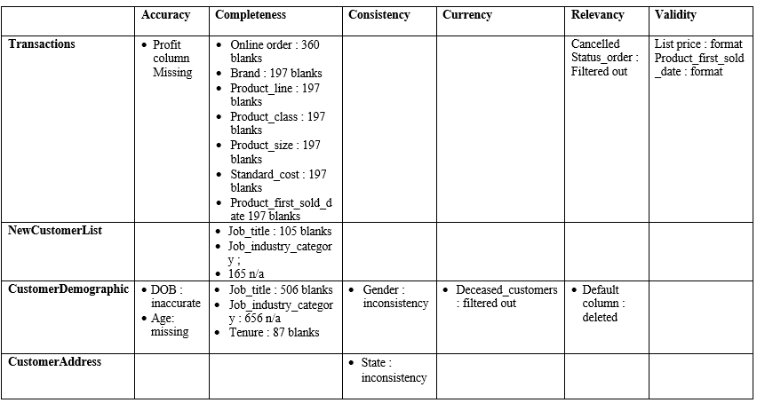
Note: The data and information in this document is reflective of a hypothetical situation and client. This document is to be used for KPMG Virtual Internship purposes only.
Data Exploration
Data Quality Assessment and Clean Up
Key Issues for Data Quality Assessment
Accuracy : Correct Values
Completeness : Data Fields with Values
Consistency : Values Free from Contradiction
Currency : Values up to Date
Relevancy : Data items with Value Meta-data
Validity : Data Containing Allowable Values
Uniqueness : Records that are Duplicated

Slide 5
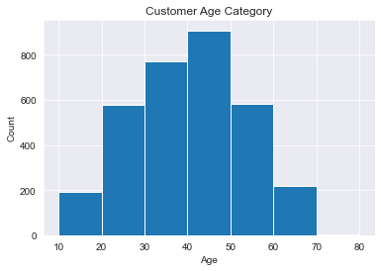
Data Exploration
Customer Age Distribution
Total customer of Sprocket Central is 3.249 customers.
Most customers age are between 40-50 years old with more than 900 people.

Slide 6
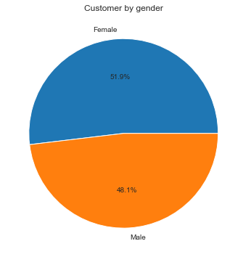
Data Exploration
Customer by Gender
Female gender have higher percentage than male with 51.9%.

Slide 7
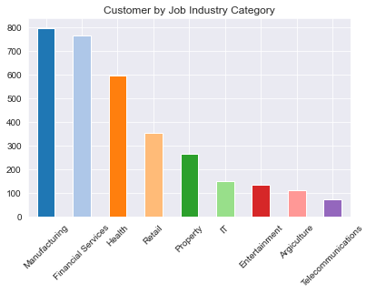
Data Exploration
Job Industry Distribution
More than 50% customer are from Manufacturing, Financial Services, and Health industry

Slide 8
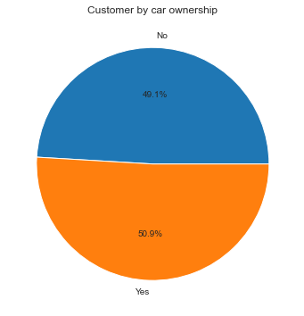
Data Exploration
Number of Cars owned and not owned by Customer
Customers who own cars are 0.9% more than customers who don't own cars.

Slide 9
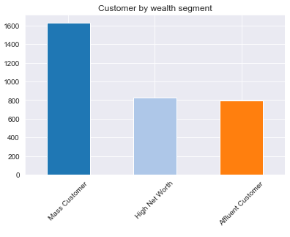
Data Exploration
Wealth Segmentation
The largest number of customers are classified as ‘Mass Customer’.
The next category is ‘High New Worth’ customers and Affluent Customer

Slide 10
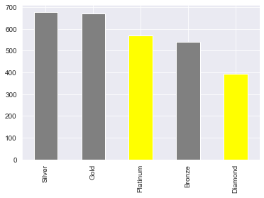
Model Development
RFM Analysis
Identifying recency, frequency and monetary of customer for clustering.
We use 1-4 scale for each R score, F score, and M score.
Customer with Diamond title is customers with highest RFM score from 11-12, and Platinum customer with RFM score 9-10.

Slide 11
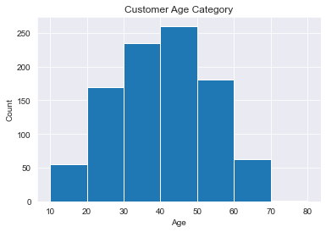
Model Development
Age Distribution of Diamond and Platinum
The targeted new customers must be in age between 20 to 60 years old.

Slide 12
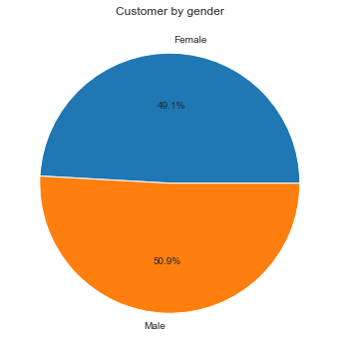
Model Development
Gender of Diamond and Platinum Customer
There is almost no difference in gender to be targeted

Slide 13
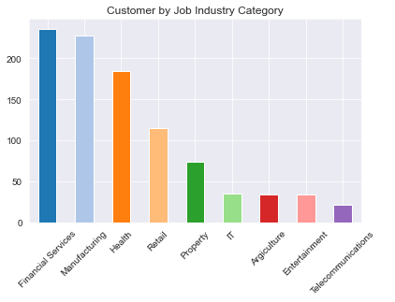
Model Development
Job Industry Distribution
More than half of customers work in Manufacturing, Financial Services, and Health industries and should be targeted.

Slide 14
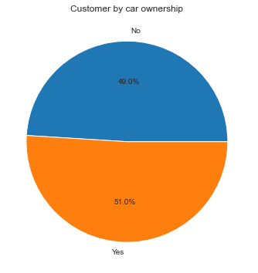
Model Development
Number of Cars owned and not owned by Customer
There is almost no difference in car ownership to be targeted.

Slide 15

Model Development
Wealth Segmentation
Mass Customers has the largest portion of the customer base in terms of wealth segment.
High Net Worth and Affluent Customer should be targeted too because they have purchasing power.

Slide 16
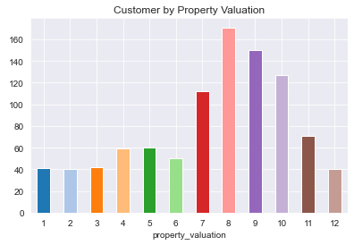
Model Development
Property Valuation
Most of customers own properties value from 7 to 10 should be targeted.

Slide 17
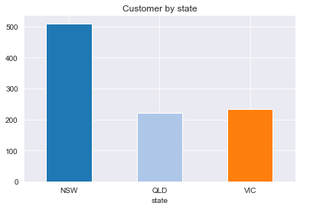
Model Development
State of Diamond and Platinum Customer
Most of customers is from NSW or New South Wales.
QLD and VIC must be targeted too because they are in different state.

Slide 18
Interpretation
Who Should be Targeted on New Customer?
The targeted new customers must be in age between 20 to 60 years old.
There is almost no difference in gender to be targeted.
There is almost no difference in car ownership to be targeted.
Mass Customers has the largest portion of the customer base in terms of wealth segment, High Net Worth and Affluent Customer should be targeted too because they have purchasing power.
More than half of customers work in Manufacturing, Financial Services, and Health industries and should be targeted.
Most of customers is from NSW or New South Wales, QLD and VIC must be targeted too because they are in different state.
Most of customers own properties value from 7 to 10 should be targeted.

Slide 19
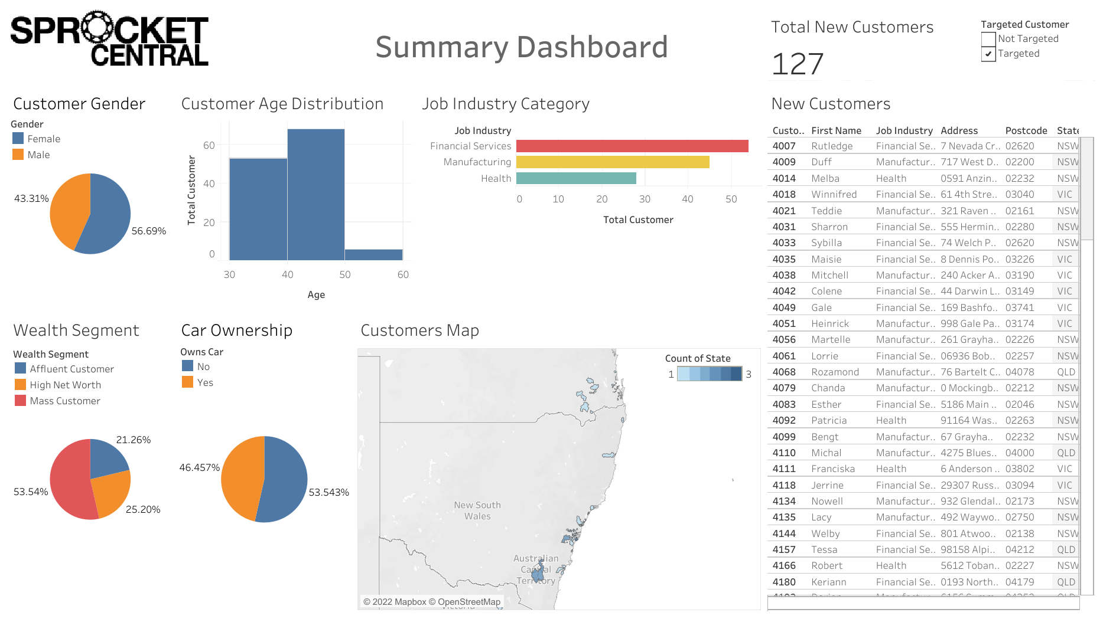
Interpretation

Slide 20
Interpretation
Dashboard Link
Link is here

